Slide 1


COVID-19 Immunity Database Management System
Reshma Kalla
rkalla@syr.edu
Anjana Sowmya Puvvada
apuvvada@syr.edu
Madhumitha Saravanan
msaravan@syr.edu
Shoumik Reddy Kumbham
skumbham@syr.edu
IST 659: Final Project Presentation

Slide 2
CONTENTS
PROJECT OVERVIEW
GOALS
ERD DATA REQUIREMENTS
CONCEPTUAL MODEL
LOGICAL MODEL
USER STORIES
LOGICAL DESIGN OF UI LAYOUT

Slide 3
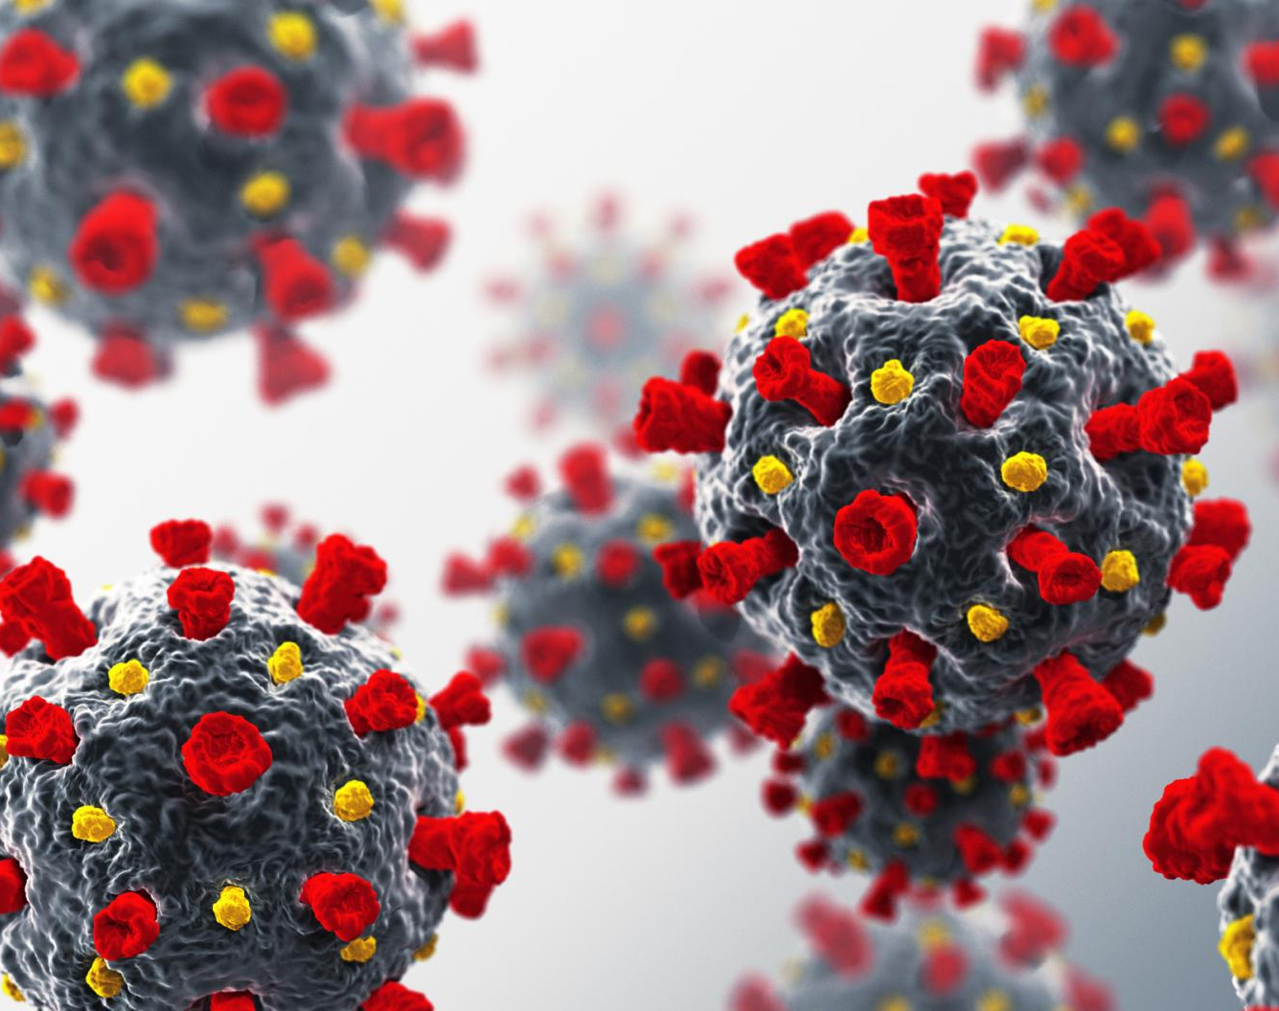
PROJECT OVERVIEW
Developing a comprehensive and secure immunity database management system that can efficiently store, manage, and share patients' immunity data related to COVID-19.

Slide 4
GOALS
Firstly, it will allow healthcare professionals to input data on vaccine recipients, including the type of vaccine received and the date of administration.
Secondly, it will track immunity levels by monitoring antibody titers and other relevant biomarkers.
Finally, it will provide real-time analytics and visualizations to help researchers analyze the data and identify trends.

Slide 5
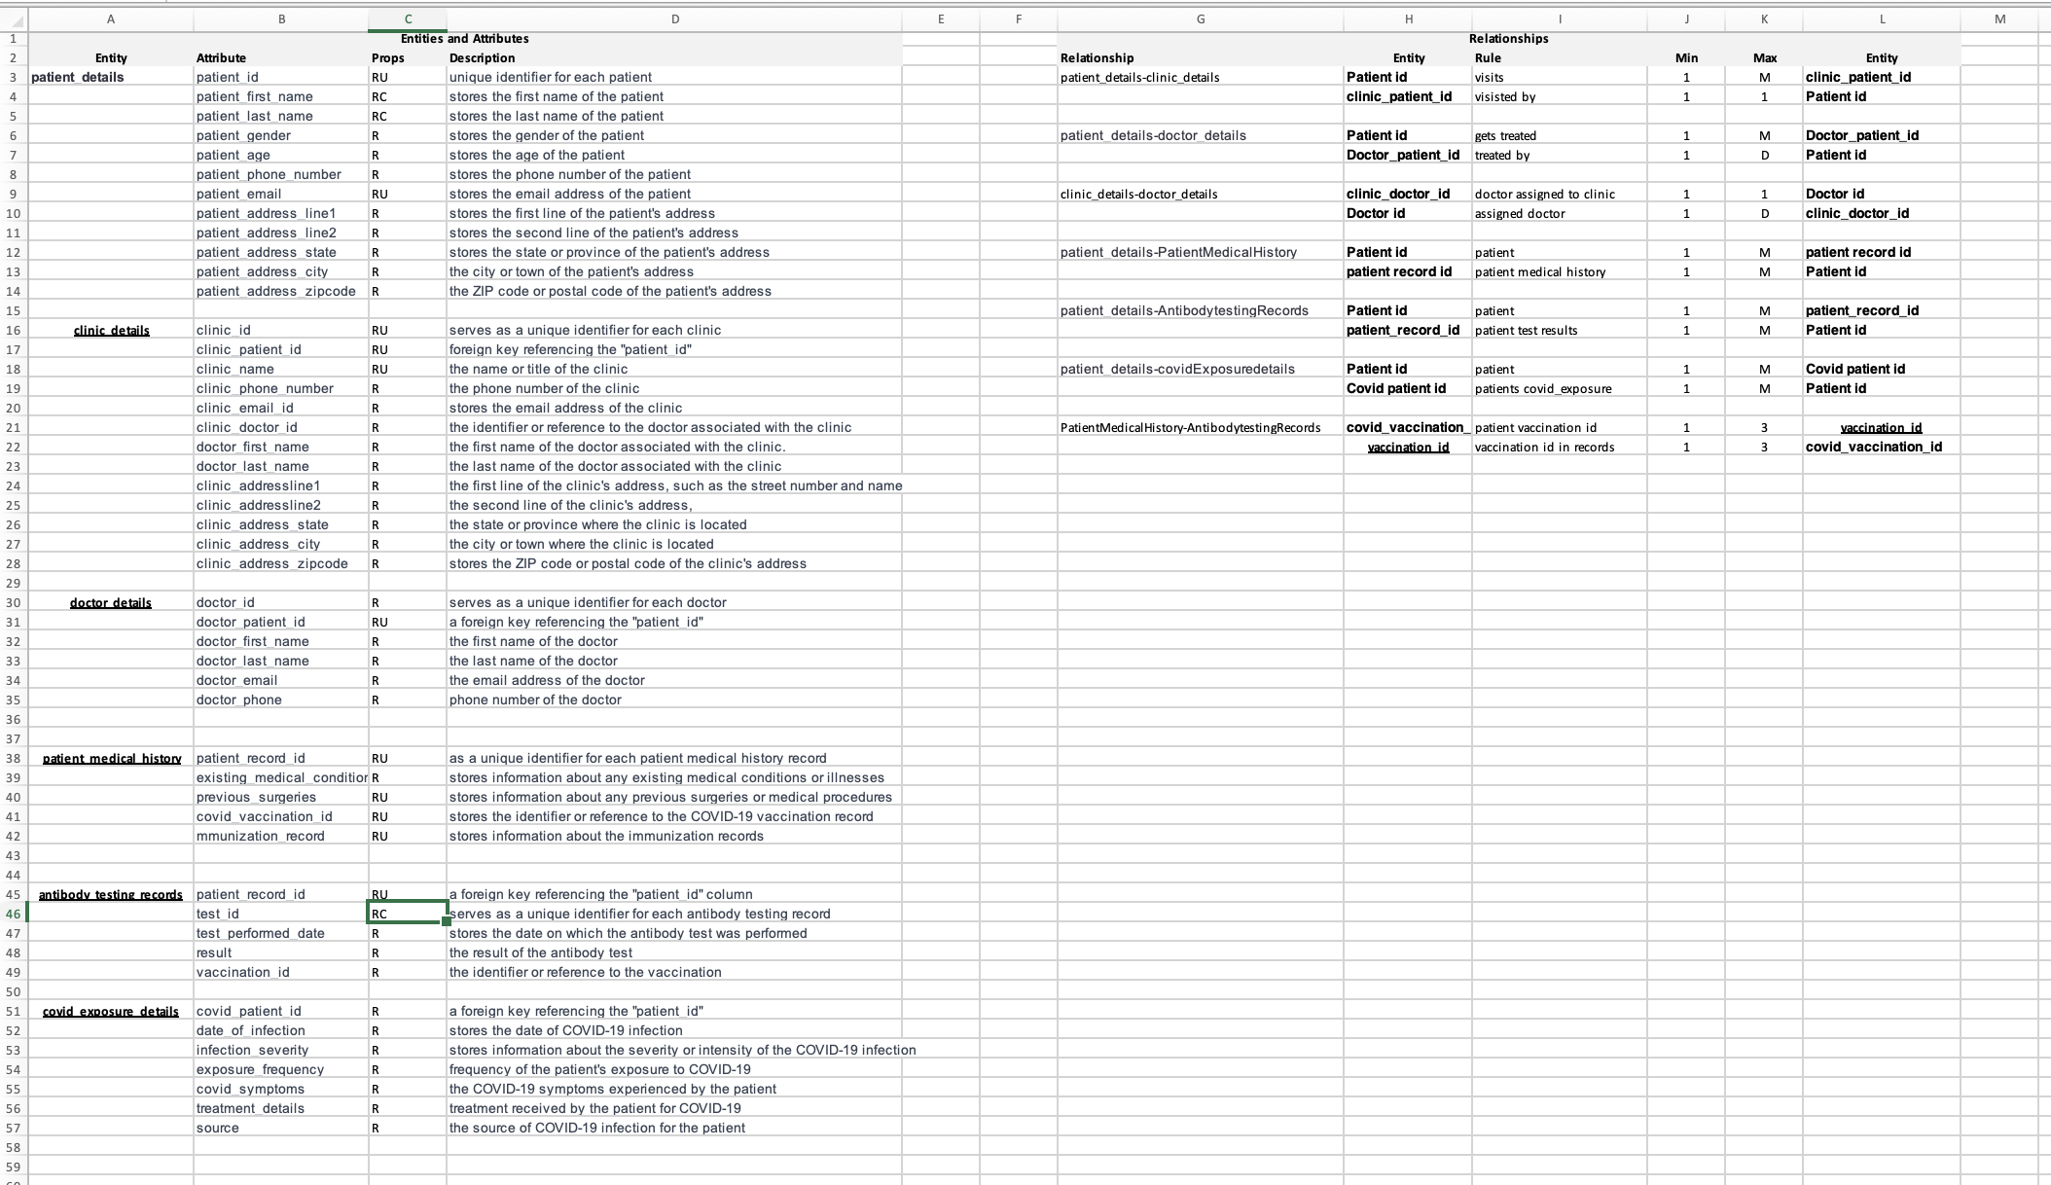
ERD DATA REQUIREMENTS

Slide 6
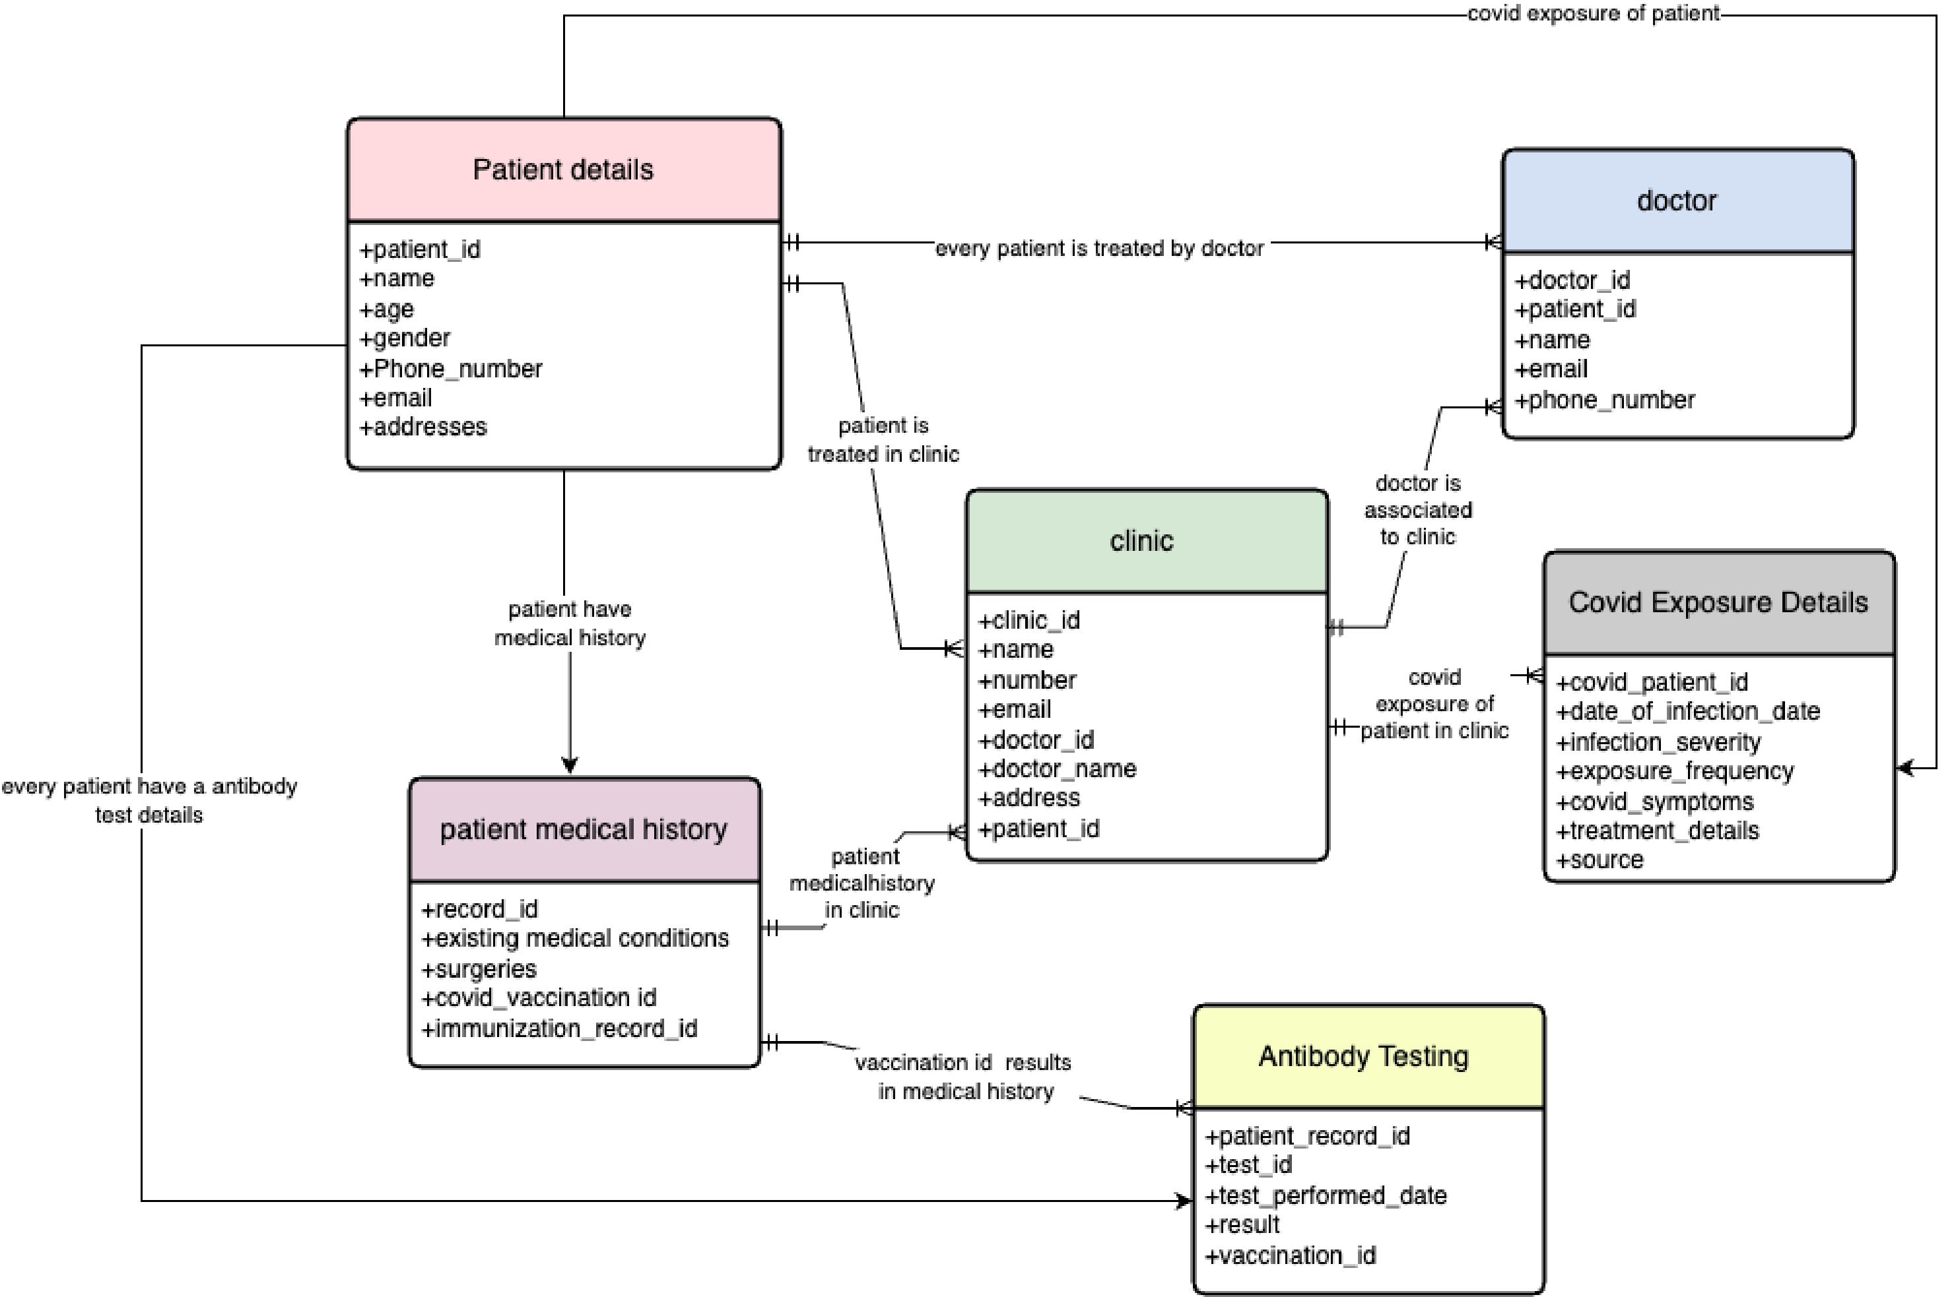
CONCEPTUAL MODEL

Slide 7
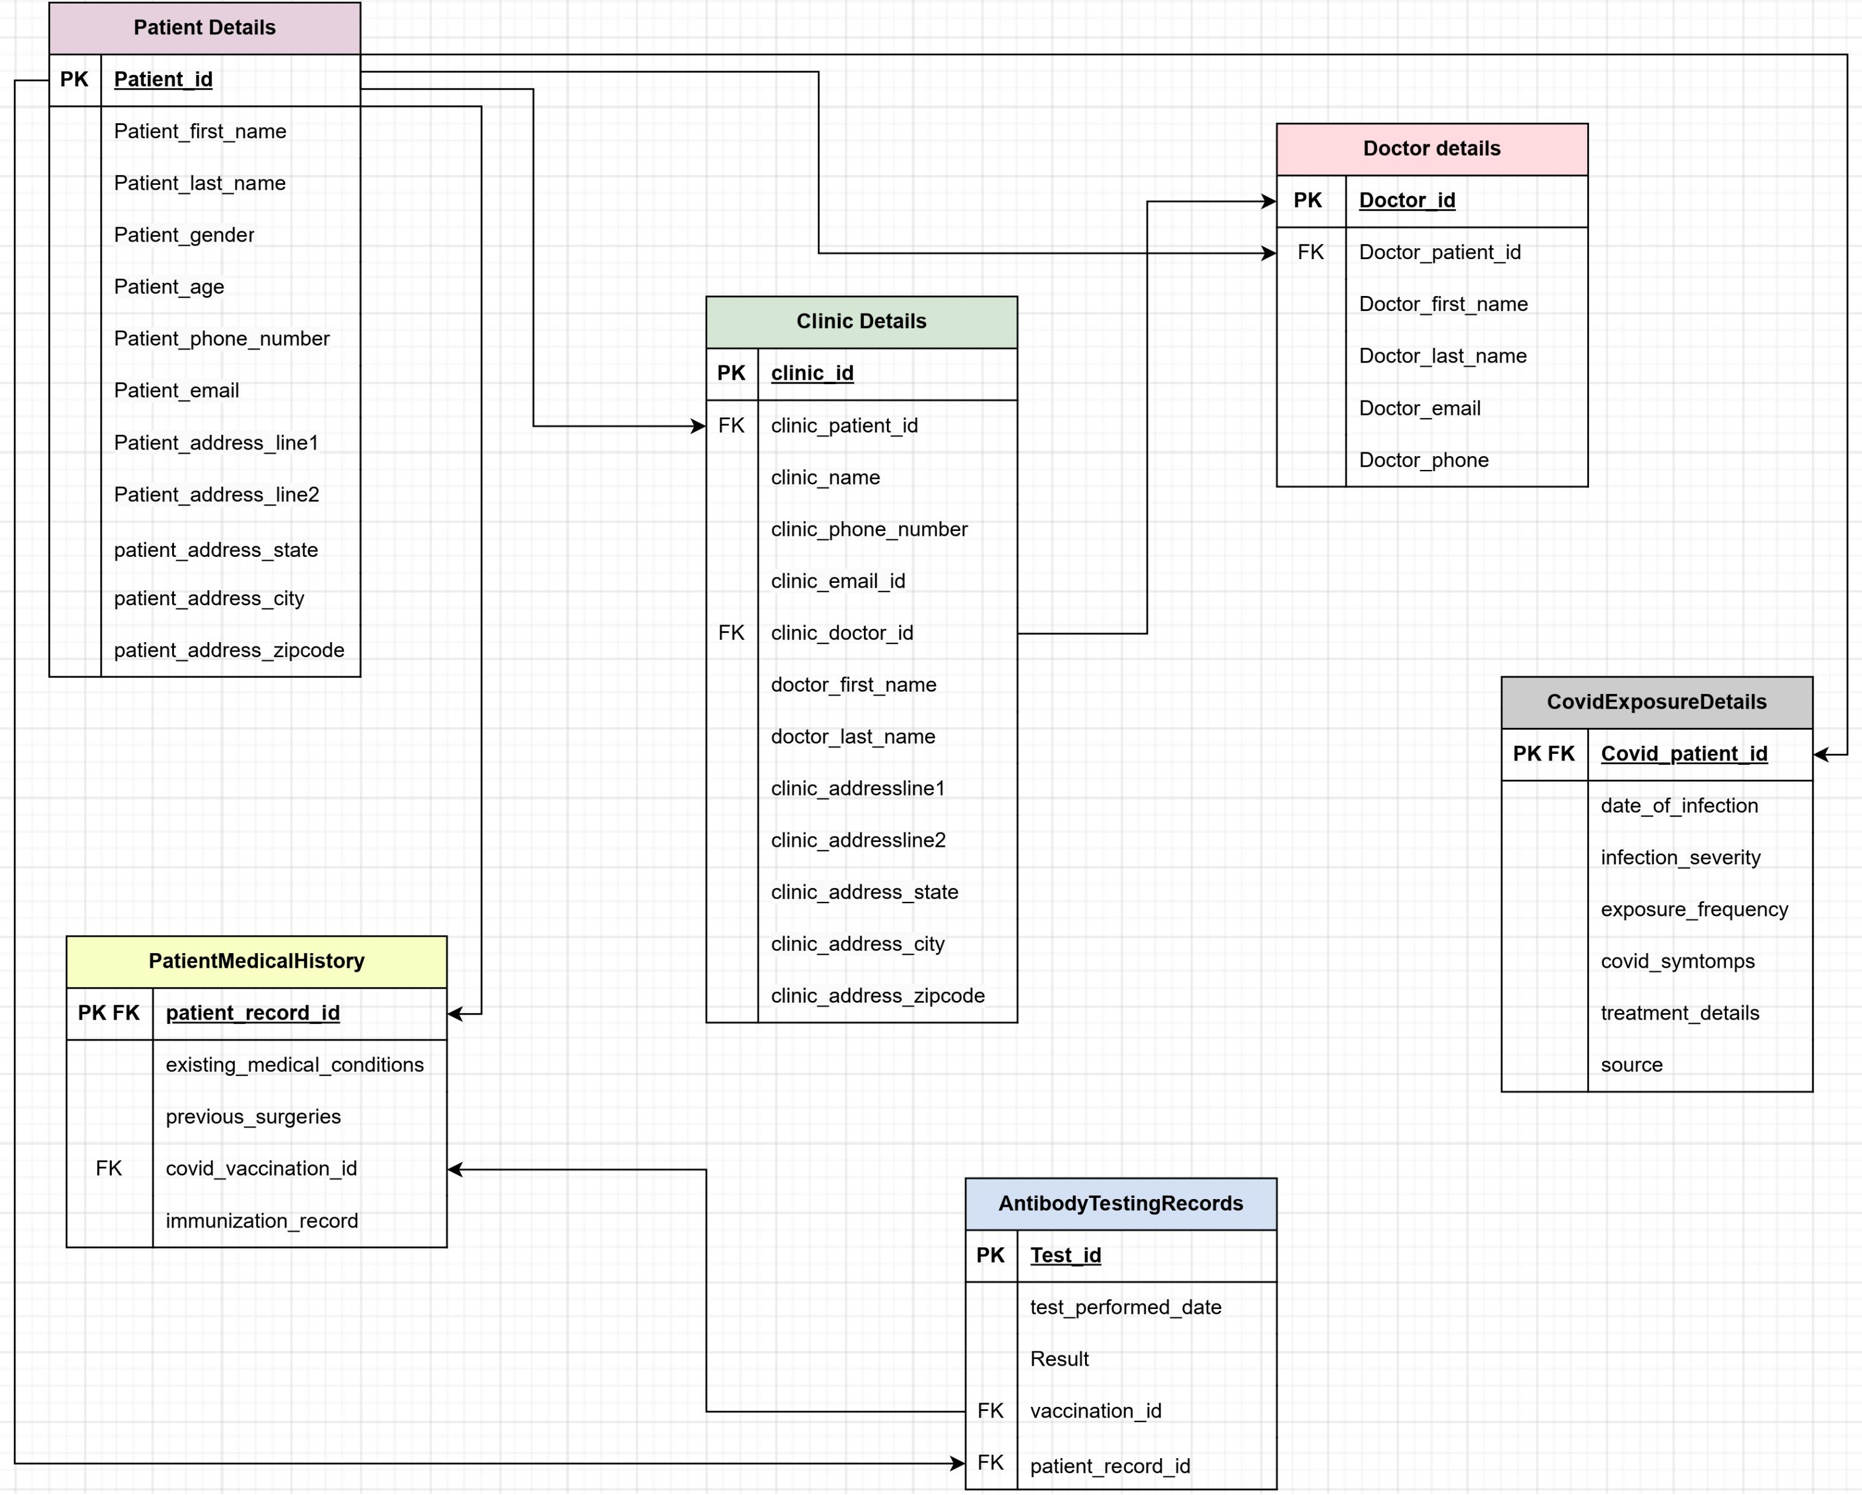
LOGICAL MODEL

Slide 8


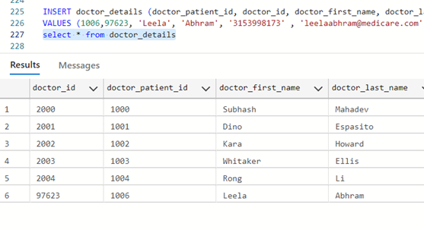
USER STORY 1
As a clinic administrator, I want to be able to add new doctors to the system, including their name, email, phone number, and patient ID, so that they can access patient records and provide care to their patients.

Slide 9
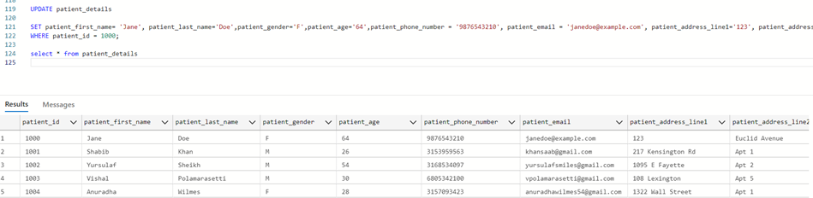
USER STORY 2
As a patient, I want to be able to update my personal information, including my name, phone number, email, and address, so that the clinic and healthcare providers have the most up-to-date information.

Slide 10
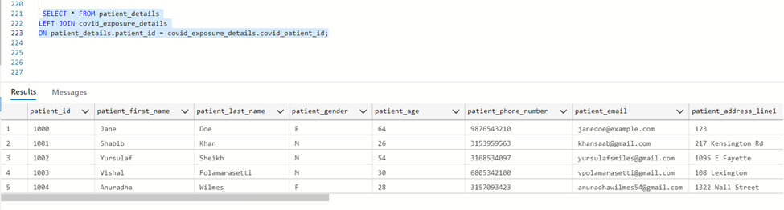
USER STORY 3
As a clinic administrator, I want to be able to view all patient records in the system, including their personal information, medical history, and COVID exposure details, so that I can monitor the health of the clinic's patients and ensure they receive appropriate care.

Slide 11
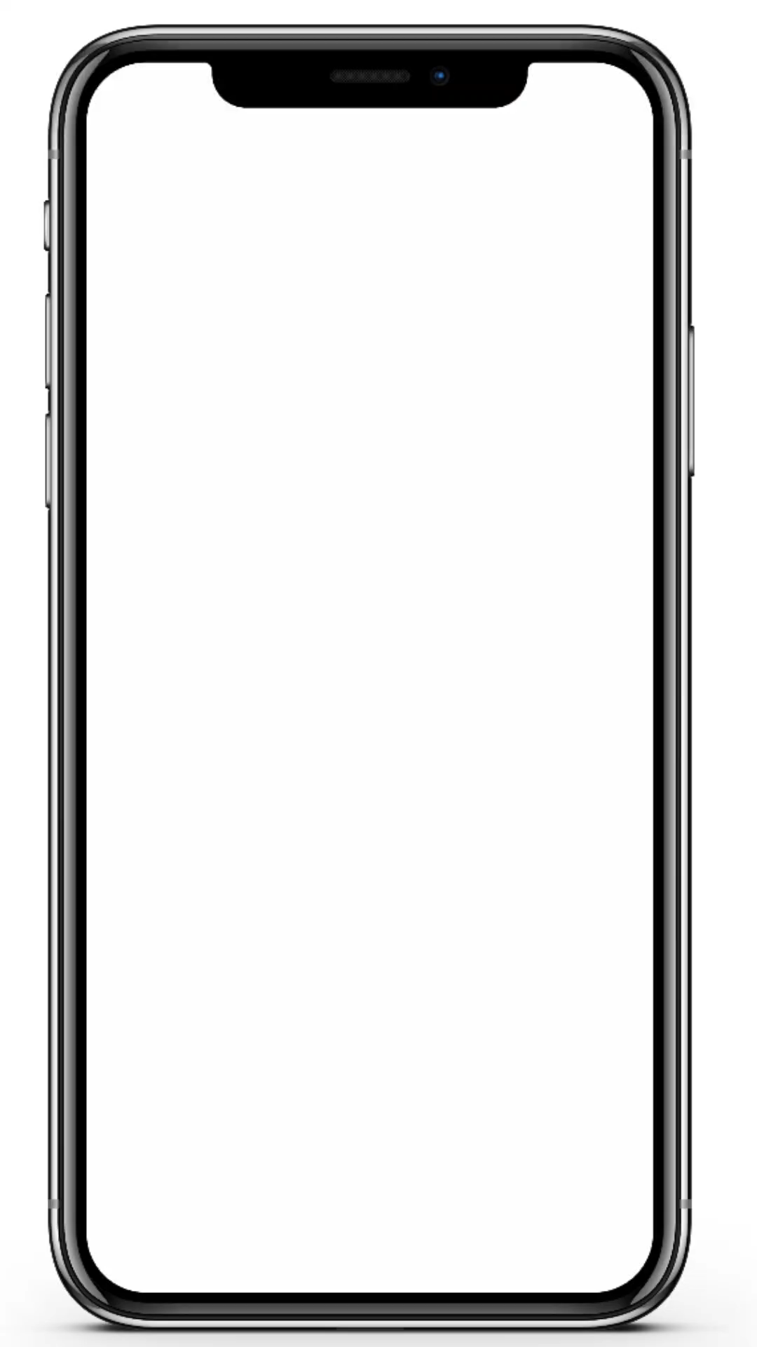
LOGICAL DESIGN OF UI LAYOUT

Slide 12


